Slide 1
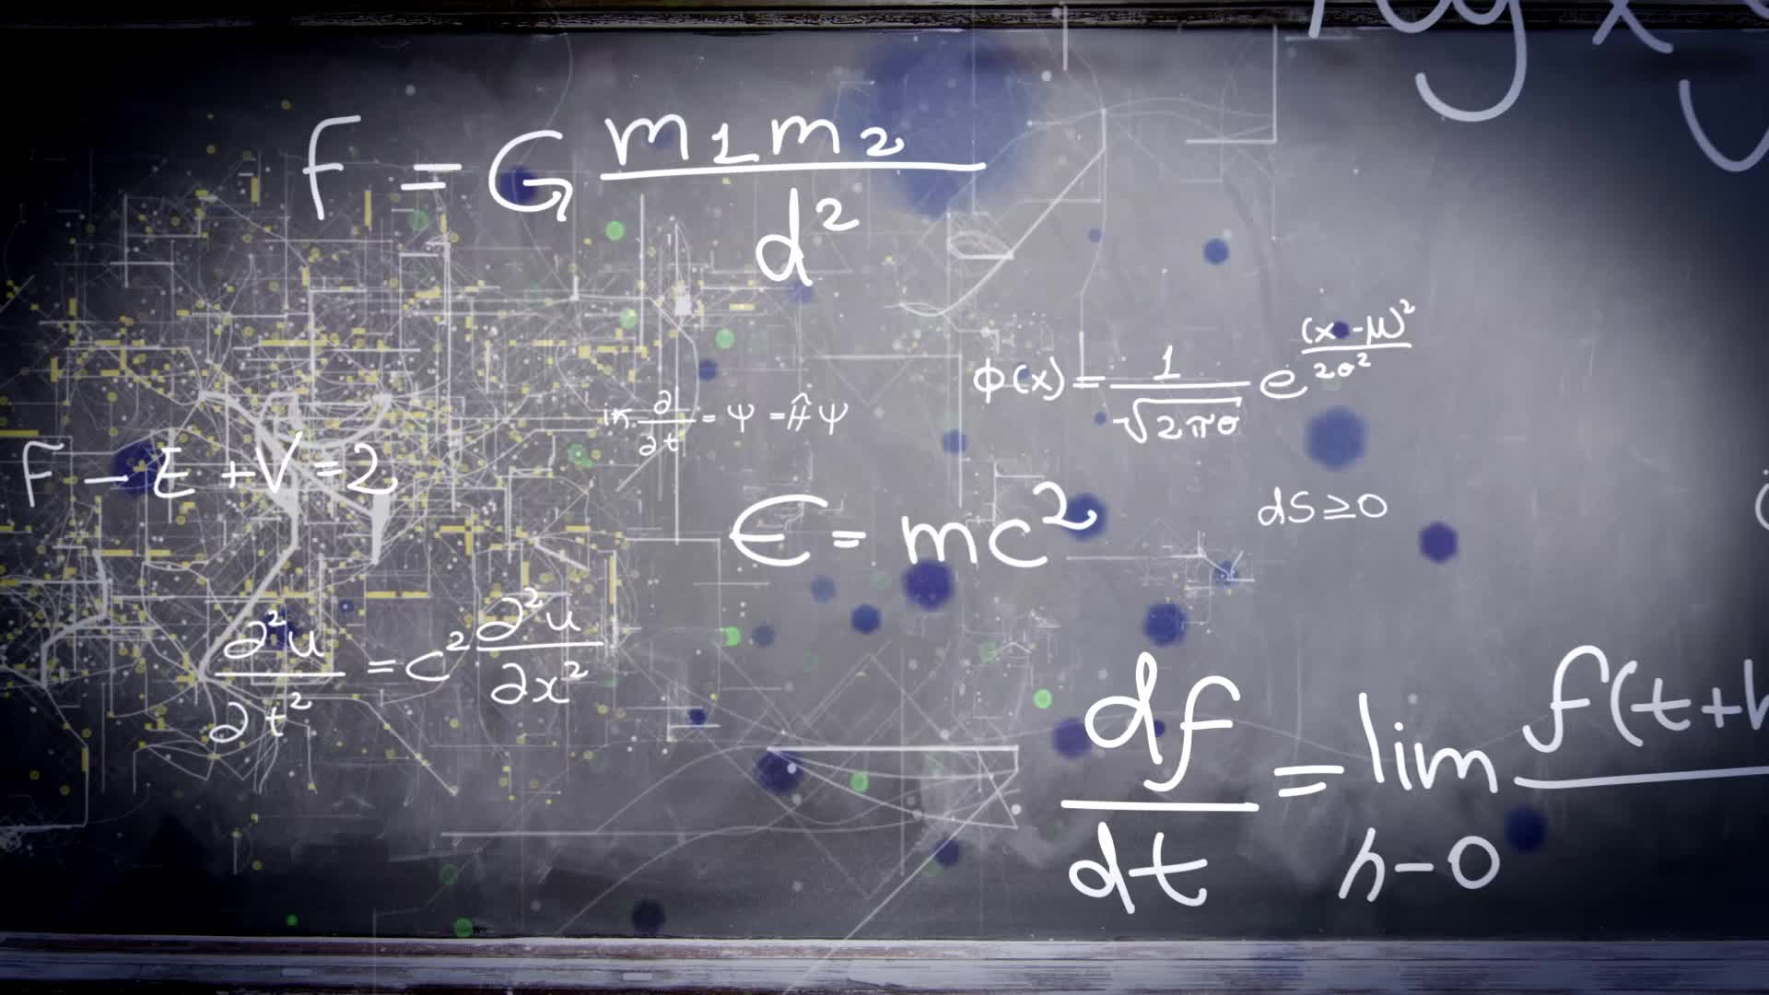
Chapter 2.2:
Basic Differentiation Rules & Rates of Change
HONORS CALCULUS/CALCULUS

Slide 2
Constant Rule: The derivative of a constant is zero.
$$\frac{d}{dx}\left[c\right]=0$$
$$f\left(x\right)=9$$
$$y=−4$$
$$s(x)=0$$

Slide 3
Power Rule: If $n$ is a rational number then:
$$\frac{d}{dx}\left[x^{n}\right]={nx}^{n−1}$$
$$f\left(x\right)=x^{3}$$
$$y=\frac{1}{x^{2}}$$
g$(x)=x$

Slide 4
Differentiate
$$y=\frac{2}{x}$$
$$g(t)=\frac{4t^{2}}{5}$$
$$\frac{d}{dx}[−\frac{3x}{2}]$$
$$f\left(x\right)=3πx$$

Slide 5
SUM AND DIFFERENCE RULES
$$\frac{d}{dx}\left[f\left(x\right)+g(x)\right]=f^{′}\left(x\right)+g′(x)$$
$$\frac{d}{dx}\left[f\left(x\right)−g(x)\right]=f^{′}\left(x\right)−g′(x)$$
$$g\left(x\right)=−\frac{x^{4}}{2}+3x^{3}−1$$
$$f\left(x\right)=3x^{2}−2x+9$$

Slide 6
Differentiate
$$y=2\sqrt{x}$$
$$y=\frac{1}{2\sqrt[3]{x^{2}}}$$

Slide 7
Derivatives of Sine and Cosine
$$\frac{d}{dx}\left[sinx\right]=cosx$$
$$\frac{d}{dx}\left[cosx\right]=−sinx$$
$$f\left(x\right)=3sinx$$
$$y=x+cosx$$

Slide 8
Find the slope and equation of the tangent line of the graph of $y=2cosx$ at the point $(\frac{π}{3}, 1)$.

Slide 9
Find the slope and equation of the tangent line of the graph of $y=3x^{2}−7x+5$ at the point $(4,25)$.

Slide 10
Horizontal Tangent
Find the point(s) on the curve $y=x^{4}−8x^{2}+4$ where the tangent line is horizontal.

Slide 11
The Average Rate of Change (Average Velocity) in distance with respect to time is given by:
$$\frac{change in distance}{change in time}=\frac{∆s}{∆t}$$
Position Function:
$$s_{0}=initial height$$
$$v_{0}=initial velocity$$
$$g=acceleration due to gravity$$
$$−32 \frac{ft}{\sec^{2}} or −9.8\frac{m}{s^{2}}$$
$$t=time$$
$$s\left(t\right)=\frac{1}{2}gt^{2}+v_{0}t+s_{0}$$
Instantaneous Velocity:
$$s^{′}(t)=v(t)$$

Slide 12
If a free-falling object is dropping from a height of 100 feet, its height $s$ at time $t$ is given by the position function $s=−16t^{2}+100$ where $s$ is measured in feet and $t$ is measured in seconds. Find the average rate of change of the following intervals.
$$[1,2]$$
$$[1,1.5]$$
$$[1,1.1]$$

Slide 13
At time $t=0$, a diver jumps from a diving board that is 32 feet above the water. The position of the diver is given by $s\left(t\right)=−16t^{2}+16t+32$ where $s$ is measured in feet and $t$ is measured in seconds.
When does the diver hit the water?
What is the diver’s velocity at impact?

Slide 14
The position of a particle is given by $s\left(t\right)=t^{3}−6t^{2}+9t$ where $s$ is measured in meters and $t$ is measured in seconds.
Find the velocity at time$t$?
What is the velocity after 2 seconds?
What is the speed after 2 seconds?
When is the particle at rest?

